Slide 1
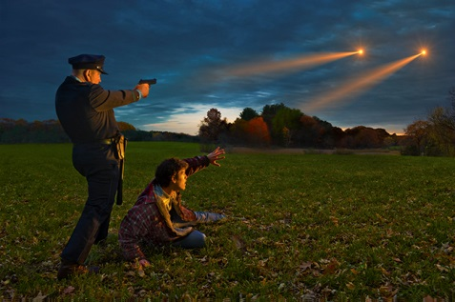
UFO Sightings
Cory Opie
Jessica Covey
James Tabinski
Kendrick Walker
Youssef Boulfrakh

Slide 2
Motivation/Summary
motivation
Questions/comparisons

Slide 3
Data Sources
Kaggle
Etc.

Slide 4

Data Cleanup
Jupyter Notebook

Slide 5
Data Analysis
Jupyter Notebook

Slide 6
Discussion - Monthly
graphics

Slide 7
Discussion - Airports
graphics

Slide 8
Discussion - Military
graphics

Slide 9
Discussion - Landmarks
graphics

Slide 10
Discussion - Shapes
graphics

Slide 11
Post Mortem
Any struggles?
Lessons learned?

Slide 12

Questions

